Slide 1
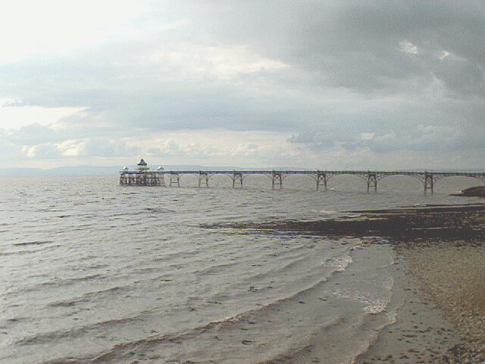

WAVES
John Parkinson
St. Brendan’s Sixth Form College

Slide 2
THE PRINCIPLE OF SUPERPOSITION
If two or more travelling waves are moving through some medium, the resultant wave displacement at any point is the algebraic sum of the individual wave displacements.
ADD THEM !!!

Slide 3
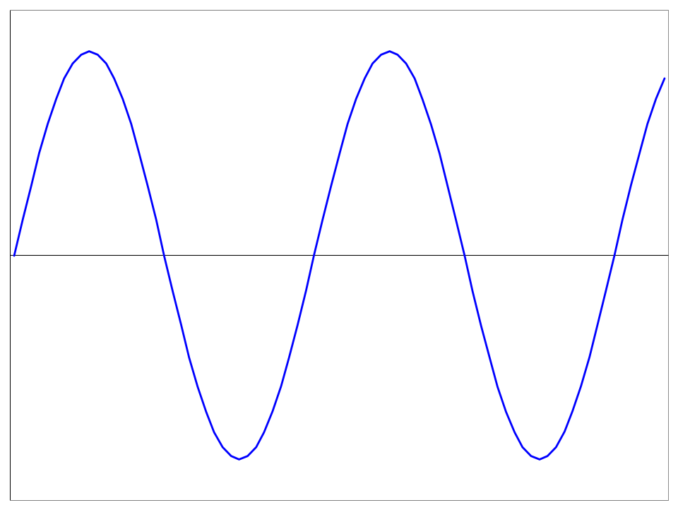
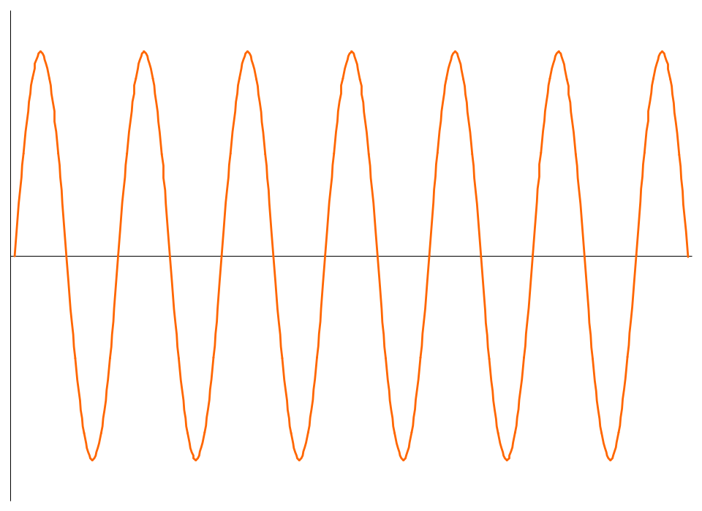
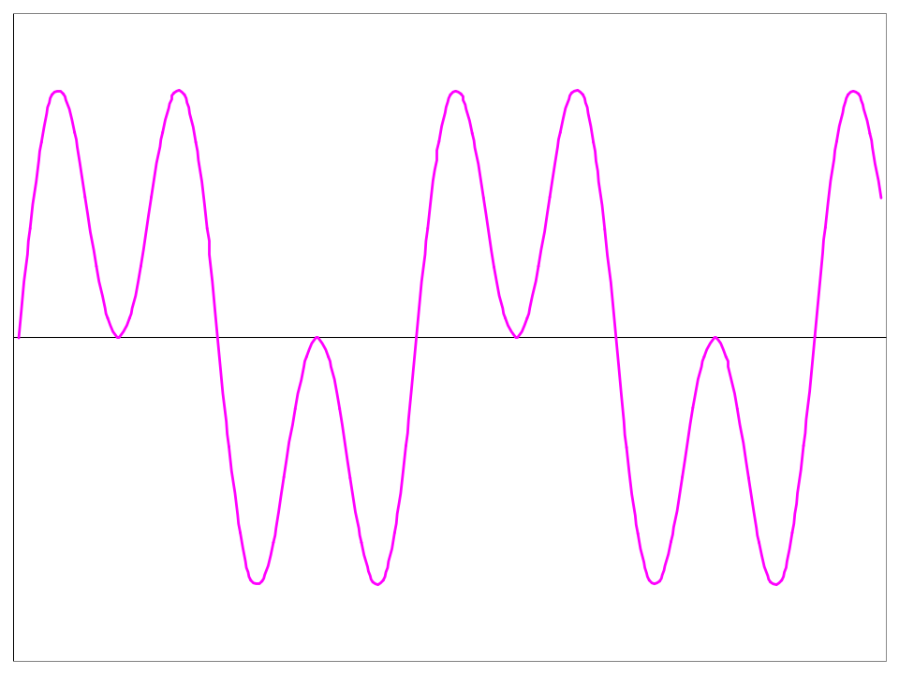
+
=

Slide 4
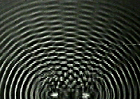
  The combination of separate waves in the same region of space to produce a resultant wave
  is called INTERFERENCE
e.g. between two dippers in a Ripple Tank
DIPPERS

Slide 5
These two waves arrive
IN PHASE
HOW DO THEY ADD UP?
+
This is called?
CONSTRUCTIVE INTERFERENCE

Slide 6
These two waves arrive in ANTI-PHASE
HOW DO THEY ADD UP?
+
This is called?
DESTRUCTIVE INTERFERENCE

Slide 7
CONDITIONS FOR A PERMANENT INTERFERENCE PATTERN
The sources must be coherent, i.e. they must be in phase with one another or they must maintain a constant phase relationship.
The sources must have the same wavelengths.
The sources must have similar amplitudes.
The sources must have the same plane of polarisation.

Slide 8
S₁ and S₂ are two coherent sources
All points on a wavefront are in phase with one another
Waves interfere constructively where wavefronts meet.
= antinodal lines
S₁
Along the nodal lines, destructive interference occurs.
Here antiphase wavefronts meet.
S₂
Wave Intensity
(Fringes)

Slide 9
Young’s Double Slits
A series of dark and bright fringes on the screen.
Monochromatic light, wavelength λ
double
slit
screen

Slide 10
Young’s Double Slits
THIS RELIES INITIALLY ON LIGHT DIFFRACTING THROUGH EACH SLIT.
Where the diffracted light overlaps, interference occurs
light
INTERFERENCE
double
slit
Some fringes may be missing where there is a minimum in the diffraction pattern
screen
Diffraction

Slide 11
Assuming the sources are coherent
Wave trains AP & BP have travelled the same distance
(same number of λ’s)
A
Hence waves arrive
in-phase
CONSTRUCTIVE
INTERFERENCE
(Bright fringe)
P
B

Slide 12
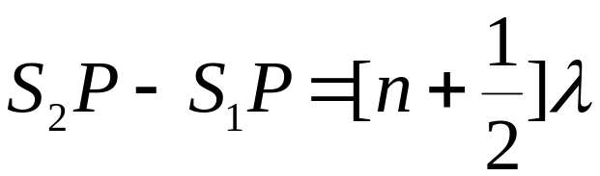
What happens at P?
When S₂P - S₁P = (1/2) of λ, the waves arrive at P in antiphase to produce a minimum or a dark fringe
The general condition for a minimum is:
P
S₁
S₂
Where n = 0, 1, 2, 3 ...

Slide 13
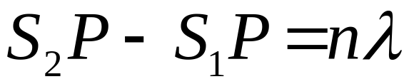
What happens at P?
When S₂P - S₁P = λ, the waves arrive at P in phase to produce a maximum intensity or a bright fringe
The general condition for a maximum is:
P
S₁
S₂
Where n = 0, 1, 2, 3 ...

Slide 14
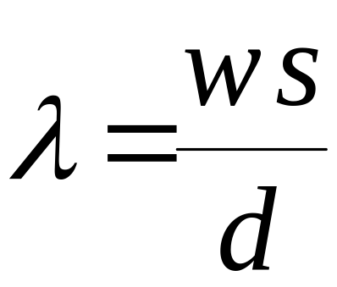
Slits
s
d
s = slit separation
Screen
w = fringe separation

Slide 15

Normal light sources emit photons at random, so they are not coherent.
LASER
LASERS EMIT COHERENT LIGHT
LASER

